Slide 1
WEEK 21
CESAR A. PASCAL VASQUEZ
Week 20 | 1

Slide 2
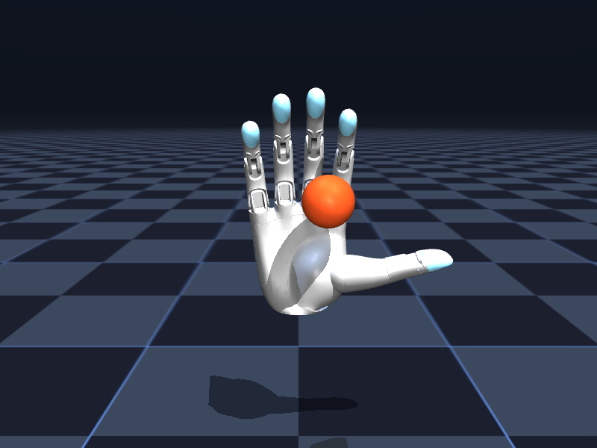
This week, the exact BrainCo Revo 2 Basic hand was moved into a runnable MuJoCo simulation.
The R1 arrived with two BrainCo Revo 2 Basic five-finger hands. I replaced the earlier generic-hand assumption with BrainCo’s released MJCF assets and built a desktop simulator for right- and left-hand interaction, command testing, and headless validation.
Week 20 | 2

Slide 3
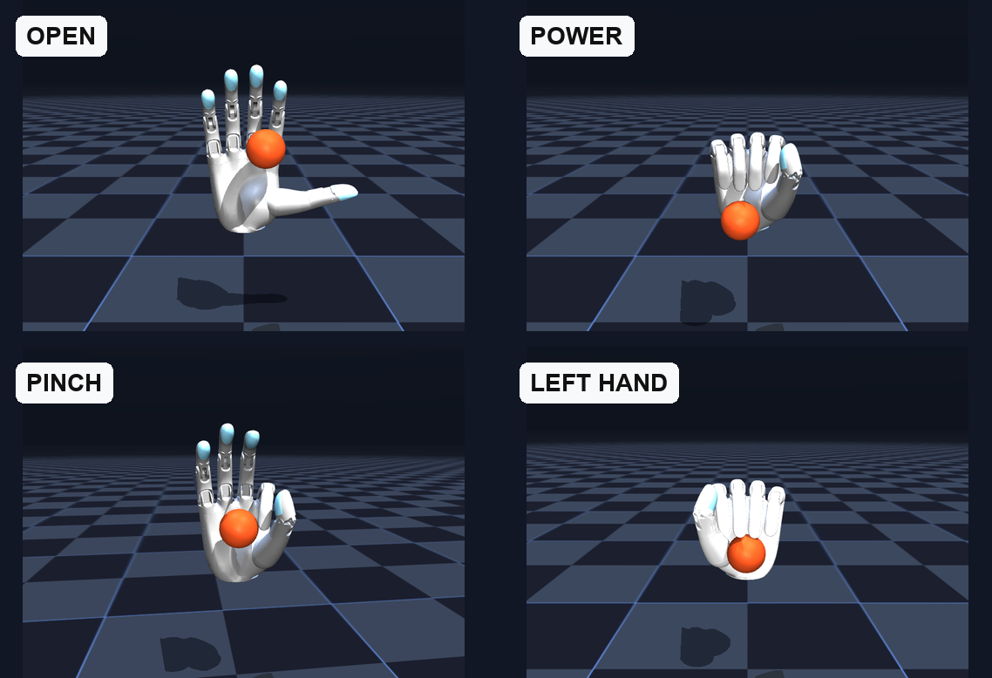
This report continues the path from locomotion and arm control to hardware-matched dexterous manipulation.
W16
W17
W18
R1 locomotion
right-arm reach
fingertip control
W19
object rotation
The progression was deliberate: finger control → object manipulation. The current model closes the hardware gap by using the actual six-command Revo 2 topology.
Week 20 | 3

Slide 4
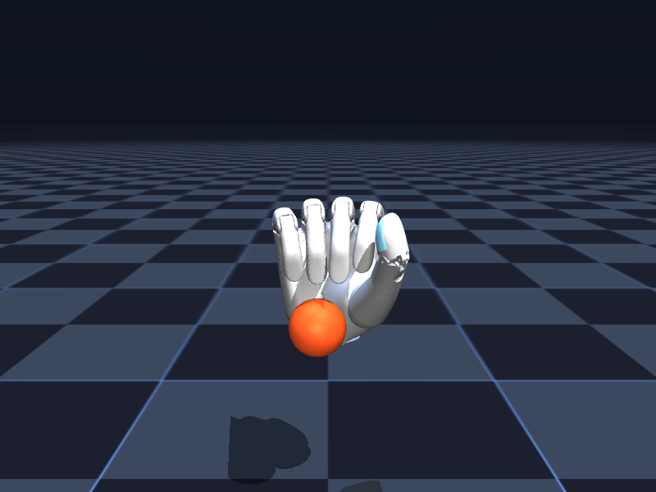
The simulated topology matches the Revo 2 Basic hand: 6 active joints and 11 total degrees of freedom.
BrainCo specifies five fingers with two active thumb motions and one active flexion command for each remaining finger. Passive distal motion brings the total to 11 mechanical degrees of freedom while control remains six-dimensional.
Power-grasp pose rendered from the official Revo 2 MJCF assets.
Hardware: BrainCo Revo 2 Basic (left + right)
Active commands: 6 per hand / 12 for both hands
Mechanical DoF: 11 per hand
Tactile module: not included on Basic edition
Interfaces: RS-485 or CAN FD
Week 20 | 4

Slide 5
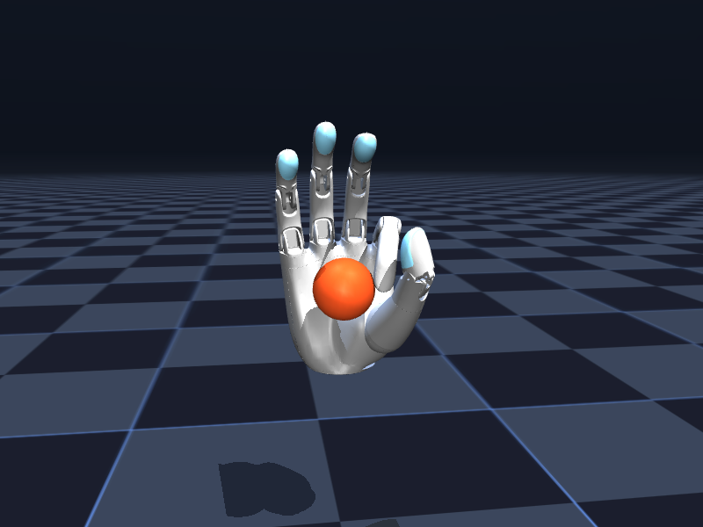
Six commands cover thumb opposition, thumb flexion, and four finger-flexion channels.
The MJCF exposes the same compact action space used by the hardware. Distal joints are coupled to their proximal finger motion, so a policy commands six actuators while the full hand articulates through 11 joints.
Pinch pose: thumb opposition + thumb flexion + index flexion.
1 Thumb opposition
2 Thumb flexion
3 Index flexion
4 Middle flexion
5 Ring flexion
6 Pinky flexion
Week 20 | 5

Slide 6
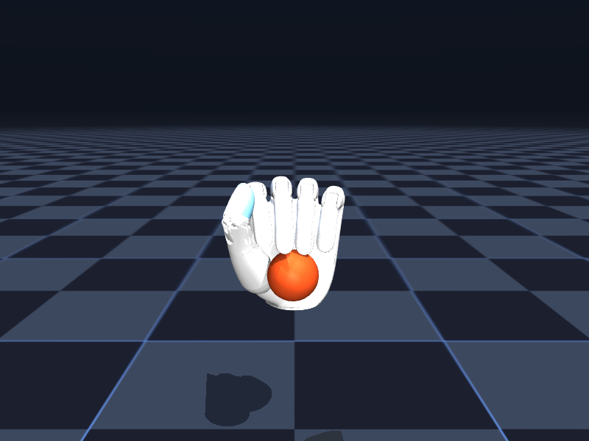
Both hands passed deterministic headless validation before use for training.
2,000
2,000
6
right-hand steps
left-hand steps
actuators per hand
PASS
finite state
The automatic grasp controller completed both runs with finite joint state and all six actuator IDs resolved. The same model also runs interactively from the desktop launcher.
Week 20 | 6

Slide 7
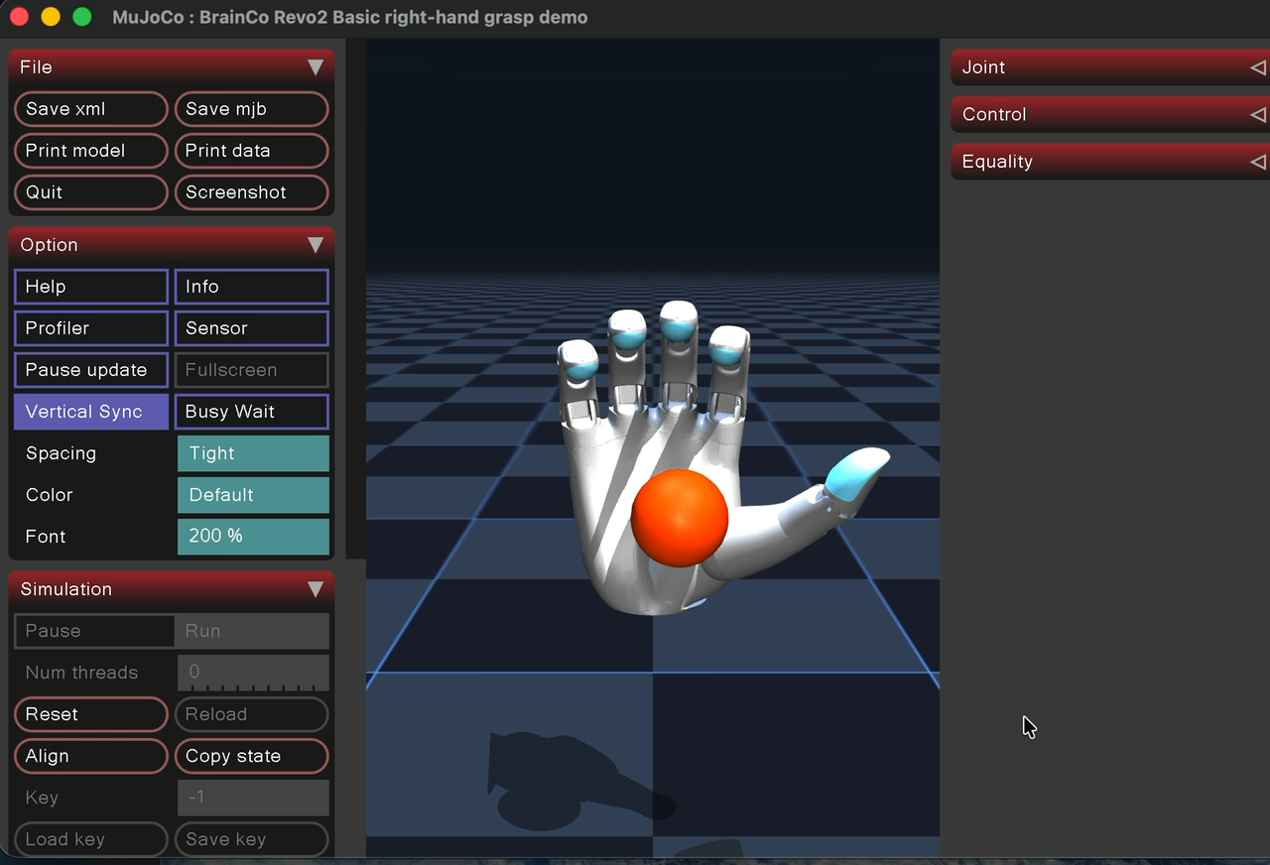
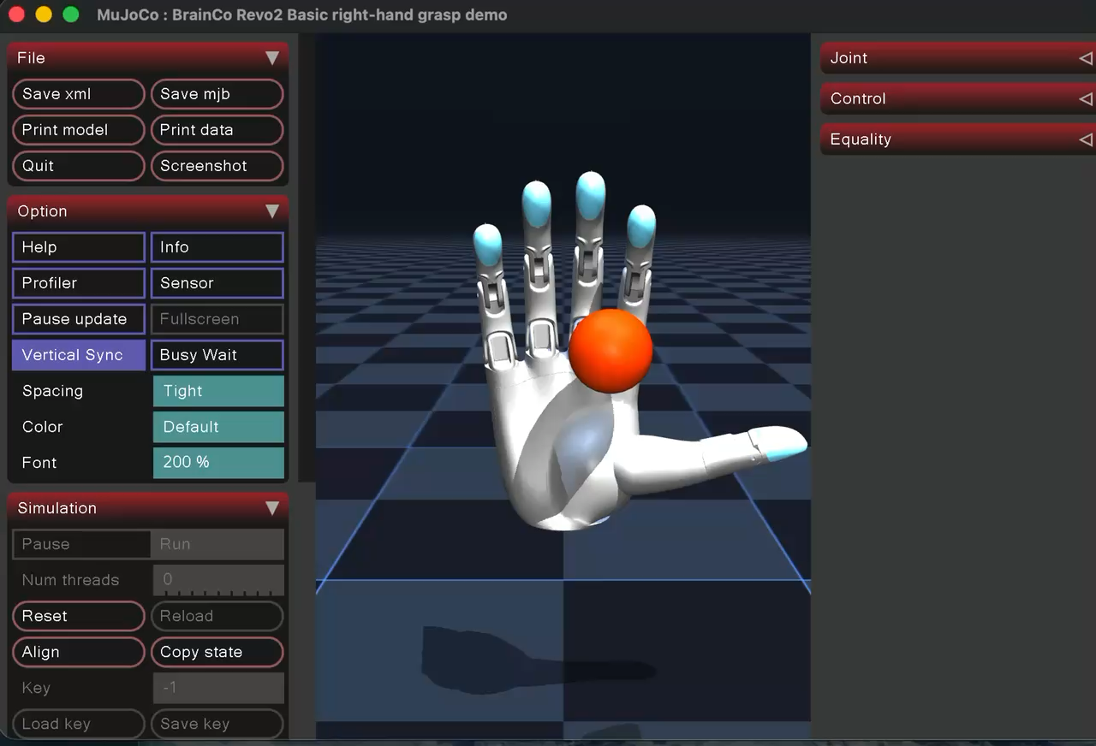
Interactive demonstration: keyboard commands drive the Revo 2 grasp poses in MuJoCo.
Video
Video 1: supplied screen recording of the right-hand interactive simulation (embedded).
Week 20 | 7

Slide 8
The hand model is training-ready, but it is not yet the complete R1 manipulation system.
This version isolates the hand at a fixed wrist and uses a free sphere for contact testing. That is the right abstraction for actuator and collision validation, but whole-body policies still need the R1 wrist transform, arm dynamics, and task sensors.
• Accurate for six-command hand kinematics and MuJoCo contacts
• Basic edition has no hardware tactile module to match in simulation
• Wrist is fixed; arm–hand coupling is not yet represented
• Sphere grasp is a demonstration, not a benchmarked RL task
• Sim-to-real calibration still needs latency and force-limit measurements
Week 20 | 8

Slide 9
Next: attach both Revo 2 models to the R1 wrists and train coordinated manipulation.
The verified hand scene is now a reusable subsystem. Integration should preserve the official meshes and actuator limits, then expose a 12-command bilateral hand action space alongside the R1 arm controller.
• Remove placeholder hand geometry from the R1 model
• Align left/right palm frames to the wrist-roll links
• Namespace and map all 12 Revo 2 commands
• Add joint, velocity, effort, and object observations
• Train a reach → grasp → hold curriculum, then validate on hardware
Week 20 | 9

Slide 10
References
BrainCo. (2026). Revo 2 overview and parameters. https://www.brainco-hz.com/docs/revolimb-hand/en/revo2/parameters.html
BrainCo. (2026). Revo 2 download center: simulation assets. https://www.brainco-hz.com/docs/revolimb-hand-dev/en/revo2/download.html
BrainCoTech. (2026). BrainCo Revo1/2 hand SDK examples. https://github.com/BrainCoTech/brainco-hand-sdk
Unitree Robotics. (2026). Serial2DDS service for BrainCo Revo2 Hand. https://github.com/unitreerobotics/brainco_hand_service
MuJoCo. (2026). XML reference. https://mujoco.readthedocs.io/en/latest/XMLreference.html
Todorov, E., Erez, T., & Tassa, Y. (2012). MuJoCo: A physics engine for model-based control. https://doi.org/10.1109/IROS.2012.6386109
Week 20 | 10

